Slide 1
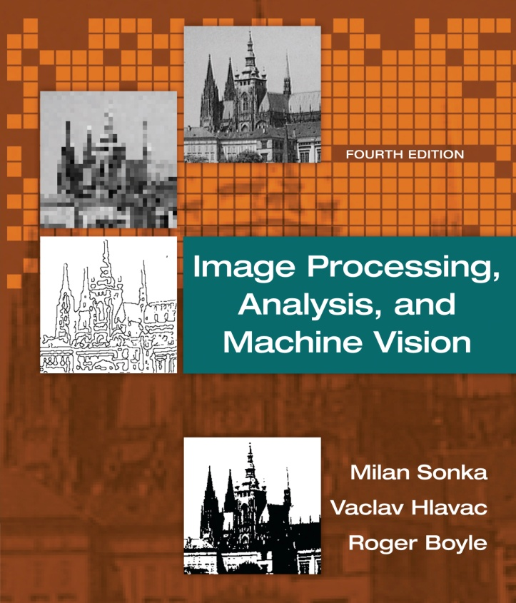

Chapter 3
Image Processing, Analysis, and Machine Vision, 4th Edition Sonka, Hlavac & Boyle
The image, its mathematical and physical background

Slide 2
Outline
Image Processing, Analysis, and Machine Vision, 4th Edition Sonka, Hlavac & Boyle
Overview
Linear integral transforms
Images as linear systems
Introduction to linear integral transforms
Fourier transform
Sampling and the Shannon constraint
Wavelet transform
Images as stochastic process
Image formation physics

Slide 3
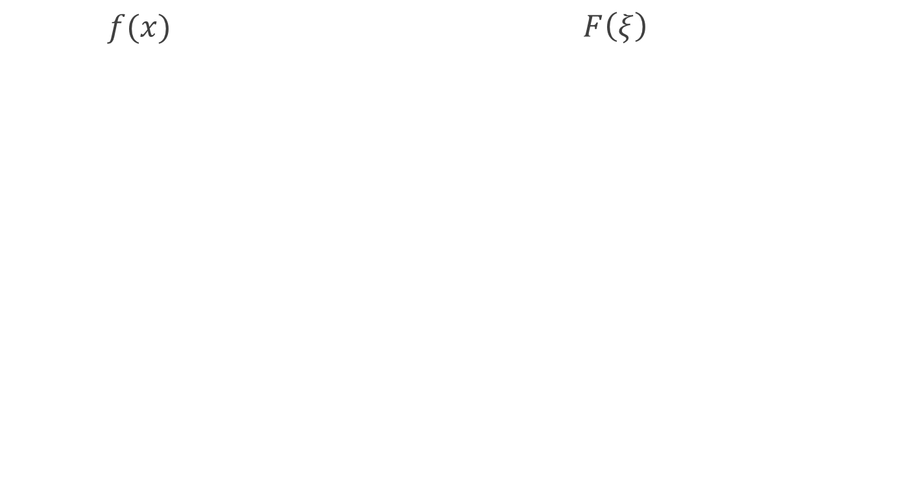
2D Fourier transform
$f(x)$ $F\left(ξ\right)$
FT
FT
FT

Slide 4
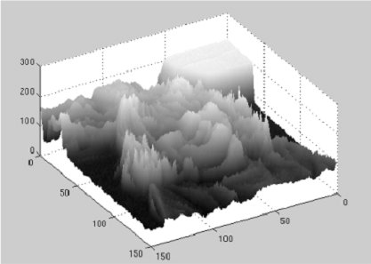

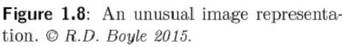
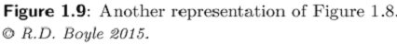
Image representation and image analysis task
Both representations contain exactly the same information.
Human observer v.s. machine recognizer

Slide 5
Selective Filtering
http://slideplayer.com/slide/8267284/

Slide 6

Selective Filtering
Notch reject filters
Notch pass filters

Slide 7
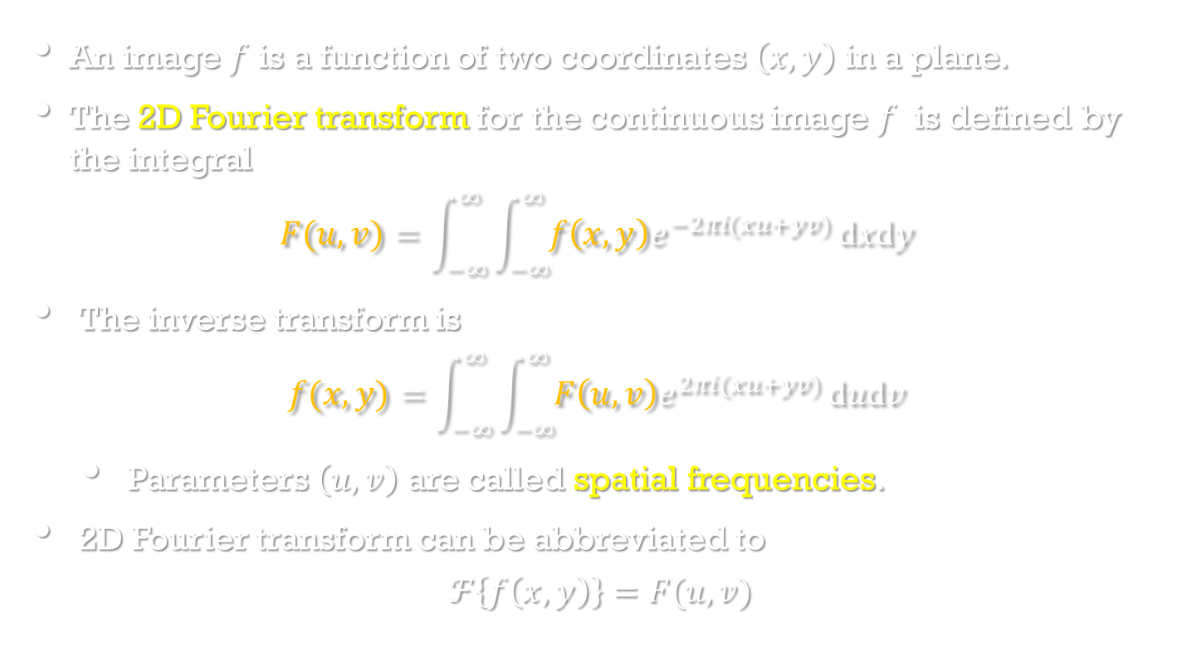
2D Fourier transform
Image Processing, Analysis, and Machine Vision, 4th Edition Sonka, Hlavac & Boyle
An image $f$ is a function of two coordinates $\left(x,y\right)$ in a plane.
The 2D Fourier transform for the continuous image $f$ is defined by the integral
$$F(u,v)=\int_{−∞}^{∞}{\int_{−∞}^{∞}{f\left(x,y\right)e^{−2πi(xu+yv)}}dxdy }$$
The inverse transform is
$$f(x,y)=\int_{−∞}^{∞}{\int_{−∞}^{∞}{F\left(u,v\right)e^{2πi(xu+yv)}}dudv }$$
Parameters $\left(u,v\right)$ are called spatial frequencies.
2D Fourier transform can be abbreviated to
$$ℱ\left\{f\left(x,y\right)\right\}=F(u,v)$$

Slide 8
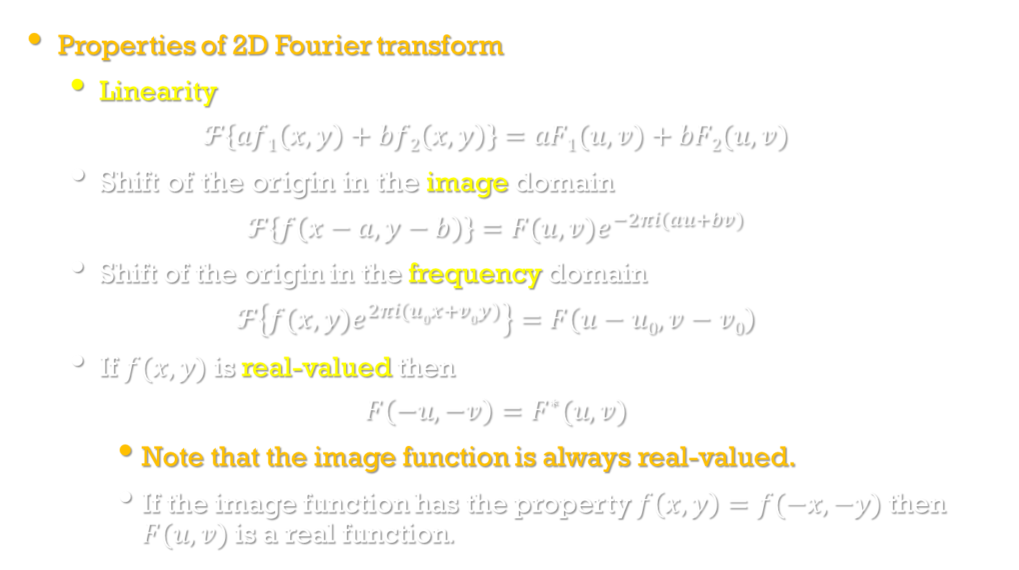
2D Fourier transform
Image Processing, Analysis, and Machine Vision, 4th Edition Sonka, Hlavac & Boyle
Properties of 2D Fourier transform
Linearity
$$ℱ\left\{af1\left(x,y\right)+bf2\left(x,y\right)\right\}=aF1(u,v)+bF2(u,v)$$
Shift of the origin in the image domain
$$ℱ\left\{f\left(x−a,y−b\right)\right\}=F(u,v)e^{−2πi(au+bv)}$$
Shift of the origin in the frequency domain
$$ℱ\left\{f(x,y)e^{2πi(u0x+v0y)}\right\}=F\left(u−u0,v−v0\right)$$
If $f(x,y)$ is real-valued then
$$F\left(−u,−v\right)=F^{∗}(u,v)$$
Note that the image function is always real-valued.
If the image function has the property $f\left(x,y\right)=f(−x,−y)$ then $F(u,v)$ is a real function.

Slide 9
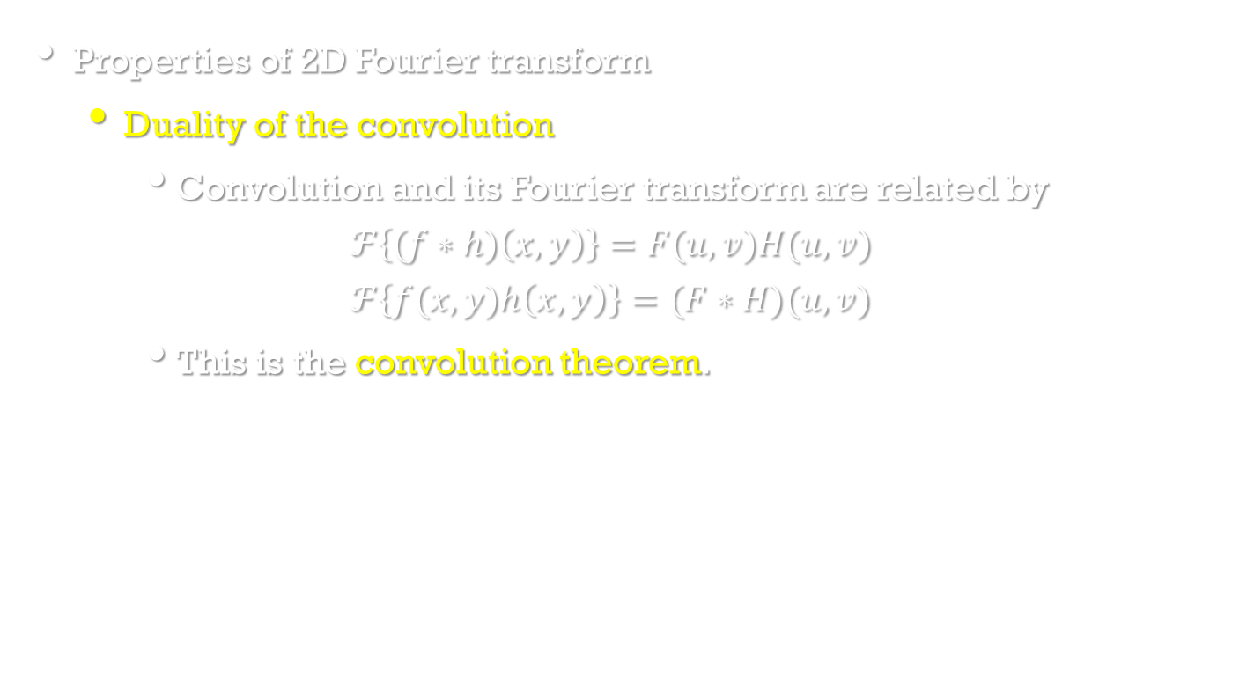
2D Fourier transform
Image Processing, Analysis, and Machine Vision, 4th Edition Sonka, Hlavac & Boyle
Properties of 2D Fourier transform
Duality of the convolution
Convolution and its Fourier transform are related by
$$ℱ\left\{(f∗h)\left(x,y\right)\right\}=F(u,v)H(u,v)$$
$$ℱ\left\{f(x,y)h\left(x,y\right)\right\}=(F∗H)(u,v)$$
This is the convolution theorem.

Slide 10
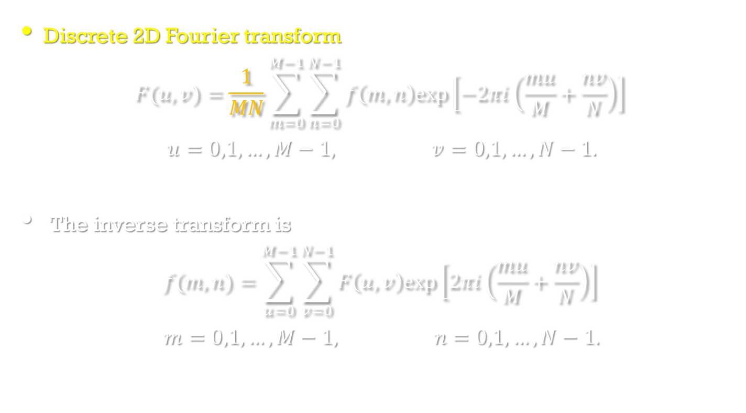
2D Fourier transform
Image Processing, Analysis, and Machine Vision, 4th Edition Sonka, Hlavac & Boyle
Discrete 2D Fourier transform
$$F(u,v)=\frac{1}{MN}\sum_{m=0}^{M−1}{\sum_{n=0}^{N−1}{f\left(m,n\right)exp⁡\left[−2πi\left(\frac{mu}{M}+\frac{nv}{N}\right)\right]}}$$
$$u=0,1,…,M−1, v=0,1,…,N−1.$$
The inverse transform is
$$f(m,n)=\sum_{u=0}^{M−1}{\sum_{v=0}^{N−1}{F\left(u,v\right)exp⁡\left[2πi\left(\frac{mu}{M}+\frac{nv}{N}\right)\right]}}$$
$$m=0,1,…,M−1, n=0,1,…,N−1.$$

Slide 11
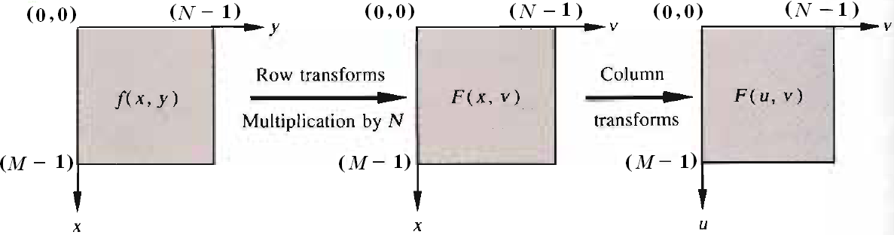
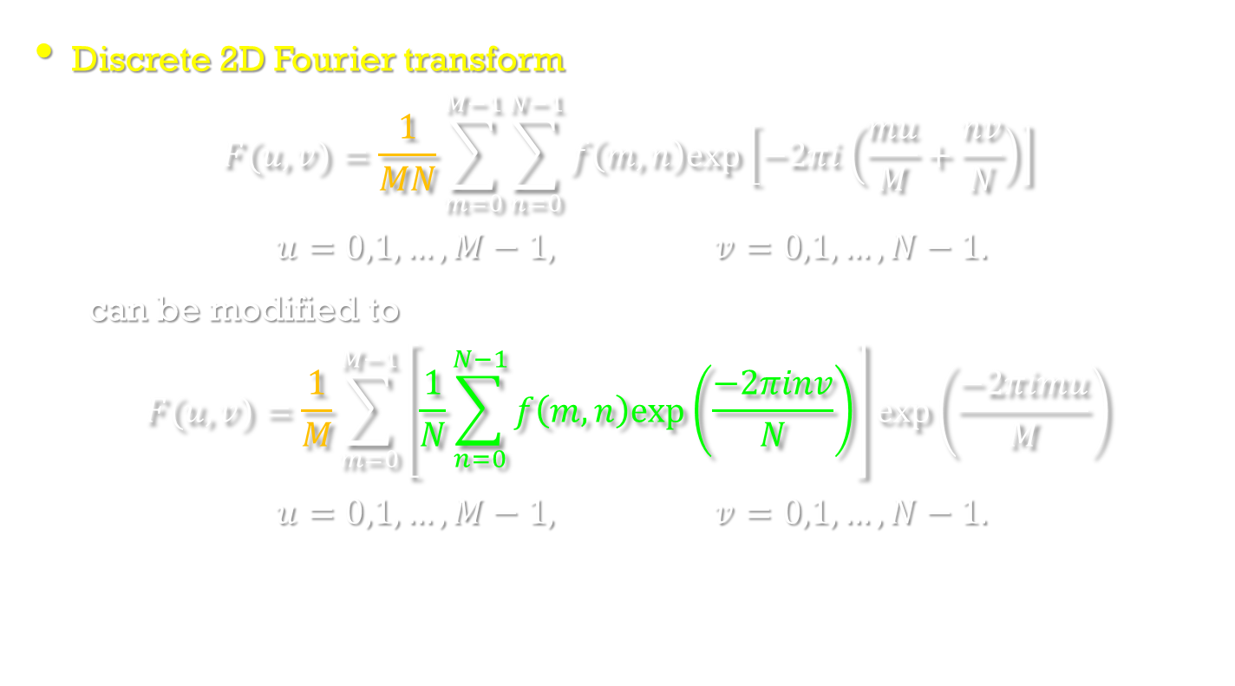
2D Fourier transform
Image Processing, Analysis, and Machine Vision, 4th Edition Sonka, Hlavac & Boyle
Discrete 2D Fourier transform
$$F(u,v)=\frac{1}{MN}\sum_{m=0}^{M−1}{\sum_{n=0}^{N−1}{f\left(m,n\right)exp⁡\left[−2πi\left(\frac{mu}{M}+\frac{nv}{N}\right)\right]}}$$
$$u=0,1,…,M−1, v=0,1,…,N−1.$$
can be modified to
$$F(u,v)=\frac{1}{M}\sum_{m=0}^{M−1}{\left[\frac{1}{N}\sum_{n=0}^{N−1}{f\left(m,n\right)exp\left(\frac{−2πinv}{N}\right)}\right]}exp\left(\frac{−2πimu}{M}\right)$$
$$u=0,1,…,M−1, v=0,1,…,N−1.$$

Slide 12

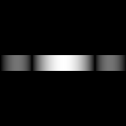

The Two-Dimensional DFT
The 2D DFT F(u,v) can be obtained by
taking the 1D DFT of every row of image f(x,y), F(u,y)
taking the 1D DFT of every column of F(u,y)
(a) f(x,y) (b)F(u,y) (c)F(u,v)

Slide 13
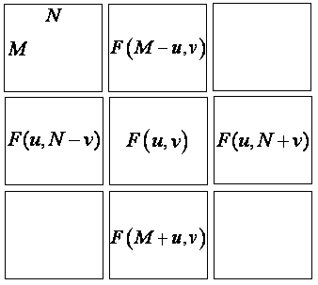
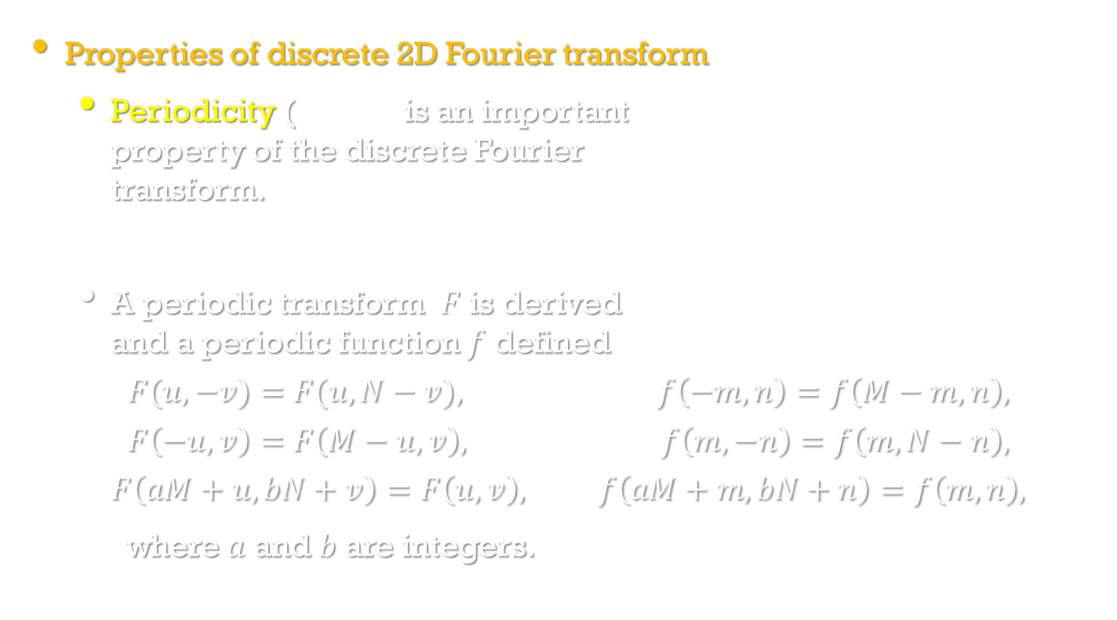
2D Fourier transform
Image Processing, Analysis, and Machine Vision, 4th Edition Sonka, Hlavac & Boyle
Properties of discrete 2D Fourier transform
Periodicity (週期性) is an important property of the discrete Fourier transform.
A periodic transform $F$ is derived and a periodic function $f$ defined
$$F(u,−v)=F(u,N−v), f\left(−m,n\right)=f\left(M−m,n\right),$$
$$F\left(−u,v\right)=F\left(M−u,v\right), f\left(m,−n\right)=f\left(m,N−n\right),$$
$$F\left(aM+u,bN+v\right)=F\left(u,v\right), f\left(aM+m,bN+n\right)=f\left(m,n\right),$$
where $a$ and $b$ are integers.

Slide 14
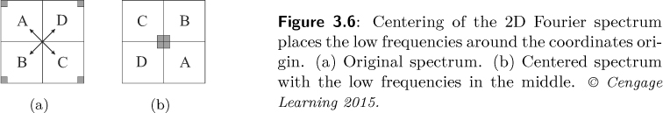
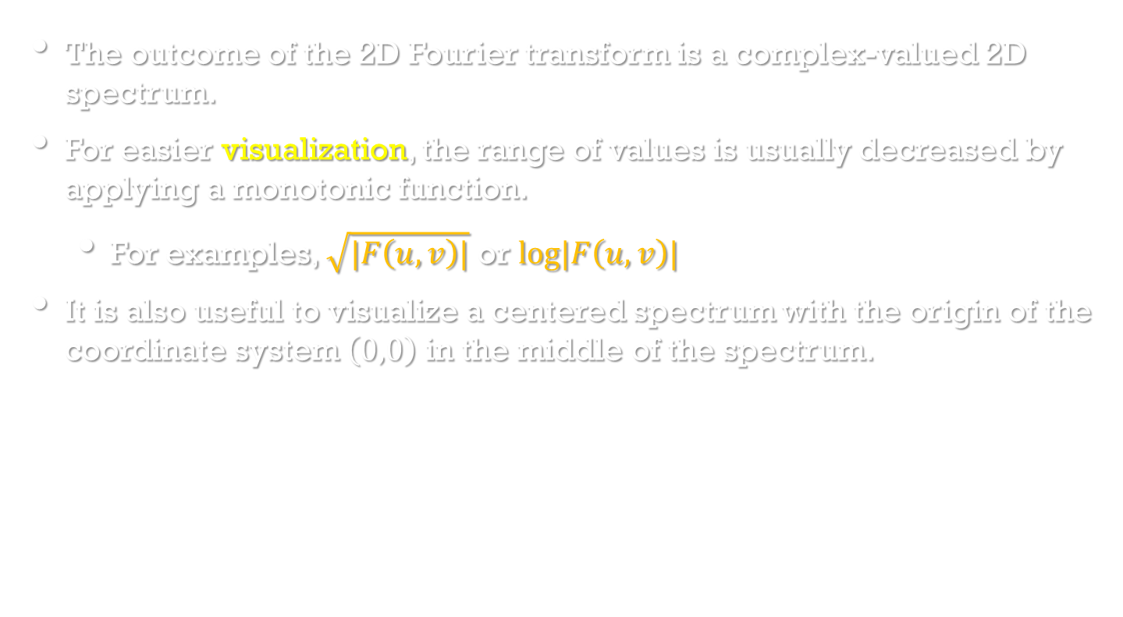
2D Fourier transform
Image Processing, Analysis, and Machine Vision, 4th Edition Sonka, Hlavac & Boyle
The outcome of the 2D Fourier transform is a complex-valued 2D spectrum.
For easier visualization, the range of values is usually decreased by applying a monotonic function.
For examples, $\sqrt{|F\left(u,v\right)|}$ or $log|F\left(u,v\right)|$
It is also useful to visualize a centered spectrum with the origin of the coordinate system $\left(0,0\right)$ in the middle of the spectrum.

Slide 15
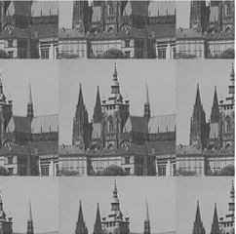
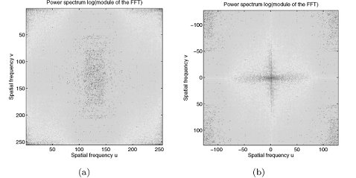
2D Fourier transform
Image Processing, Analysis, and Machine Vision, 4th Edition Sonka, Hlavac & Boyle
An example of 2D Fourier transform

Slide 16
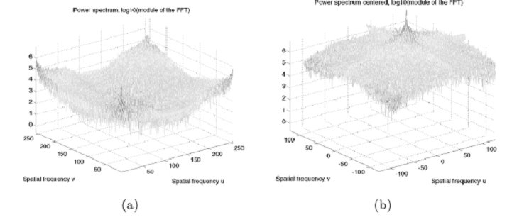
Image Processing, Analysis, and Machine Vision, 4th Edition Sonka, Hlavac & Boyle
Power spectrum displayed as height in a 3D mesh

Slide 17
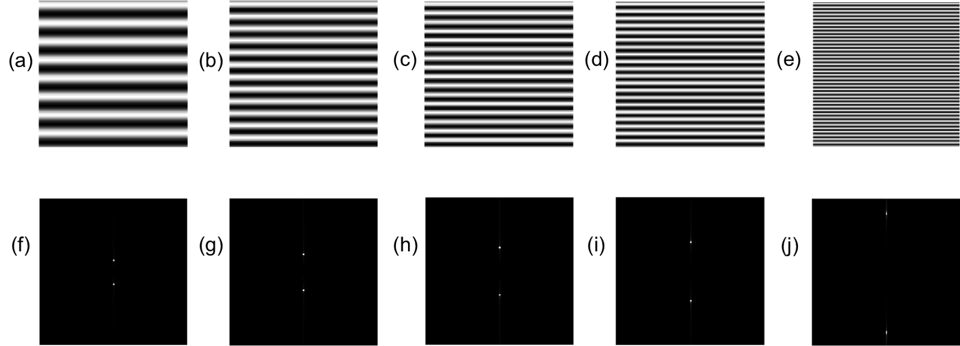
2D Fourier transform
http://kirbycheng.blogspot.tw/2011_07_01_archive.html

Slide 18
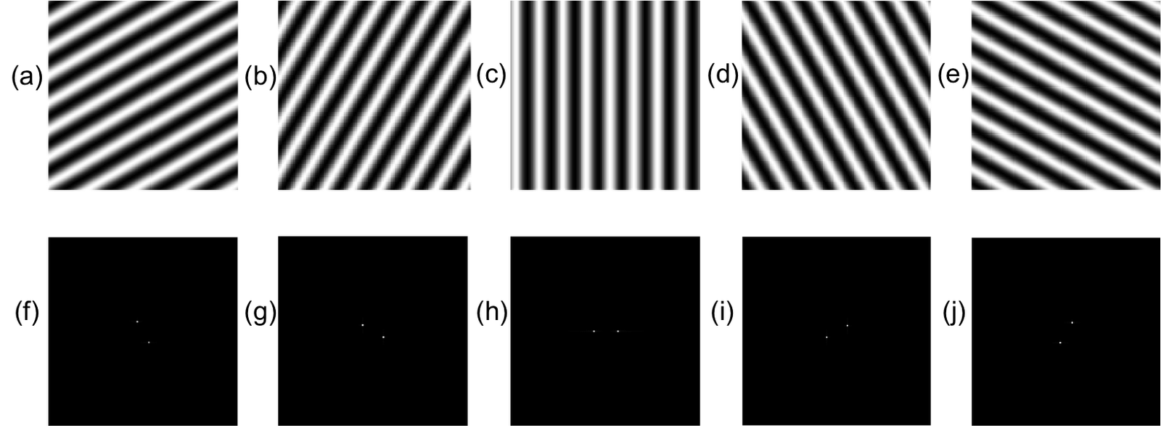
2D Fourier transform
http://kirbycheng.blogspot.tw/2011_07_01_archive.html

Slide 19
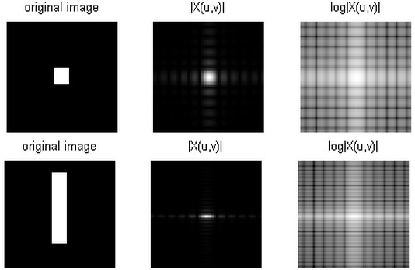
2D Fourier transform
http://dsp.stackexchange.com/questions/18670/2d-fourier-transform-most-people-cant-explain-this

Slide 20
Programs of 2D Fourier transform
http://www.ejectamenta.com/Imaging-Experiments/fourierimagefiltering.html
https://www.ejectamenta.com/Fourifier-fullscreen/
https://github.com/Lung-Yu/ImageToolBox/
http://jcrystal.com/products/ftlse/index.htm
http://bigwww.epfl.ch/demo/ip/demos/11-FFT/
http://www.jcrystal.com/products/ftlse/index.htm

Slide 21
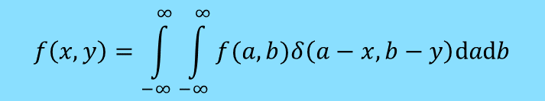
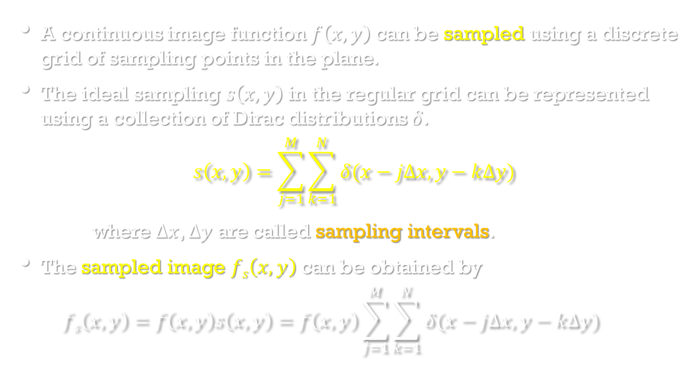
Sampling and the Shannon constraint
Image Processing, Analysis, and Machine Vision, 4th Edition Sonka, Hlavac & Boyle
A continuous image function $f\left(x,y\right)$ can be sampled using a discrete grid of sampling points in the plane.
The ideal sampling $s\left(x,y\right)$ in the regular grid can be represented using a collection of Dirac distributions $δ$.
$$s\left(x,y\right)=\sum_{j=1}^{M}{\sum_{k=1}^{N}{δ(x−j∆x, y−k∆y)}}$$
where $∆x$, $∆y$ are called sampling intervals.
The sampled image $fs\left(x,y\right)$ can be obtained by
$$fs\left(x,y\right)=f\left(x,y\right)s\left(x,y\right)=f\left(x,y\right)\sum_{j=1}^{M}{\sum_{k=1}^{N}{δ(x−j∆x, y−k∆y)}}$$
$$f\left(x,y\right)=\int_{−∞}^{∞}{\int_{−∞}^{∞}{f(a,b)δ\left(a−x,b−y\right)dadb}}$$

Slide 22
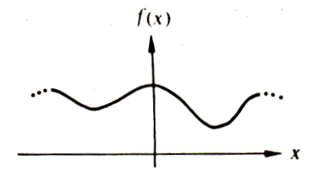
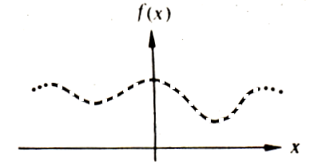
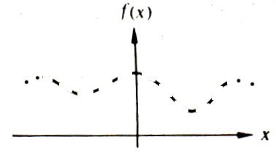
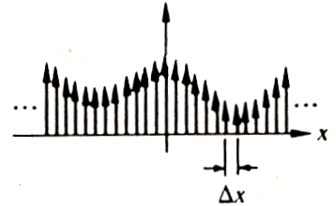
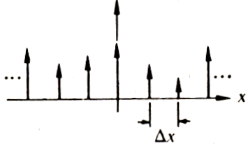
Sampling theory
Continuous function
Discrete function
Dense sampling
Sparse sampling
How many samples should be taken so that no information is lost in the sampling process?

Slide 23
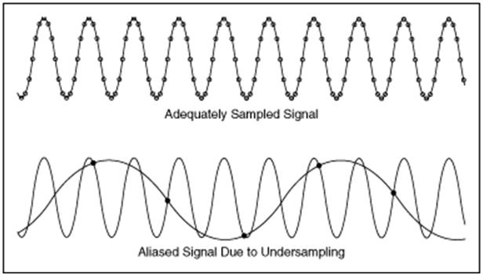
Aliasing
http://www.ni.com/white-paper/10669/en/

Slide 24
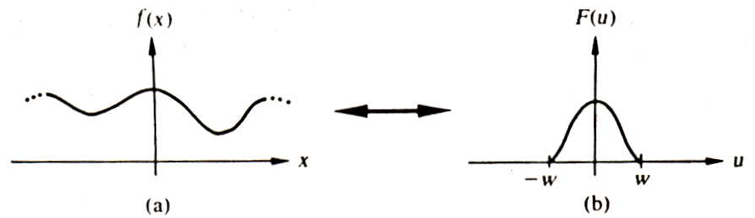
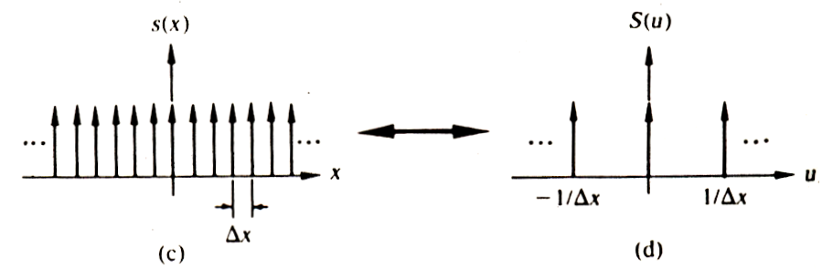
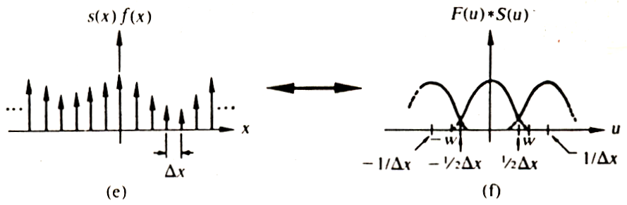
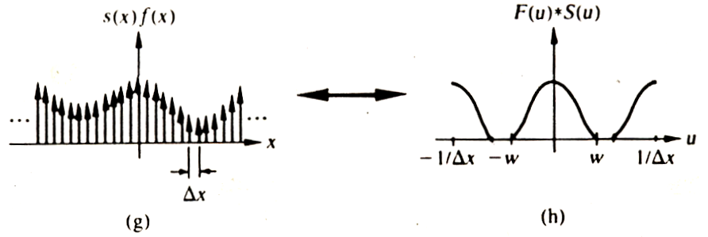
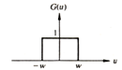
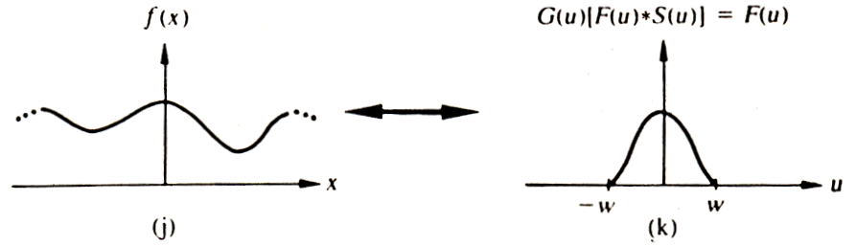
Spatial domain Frequency domain
f(x): band-limited function
s(x): sampling function

Slide 25
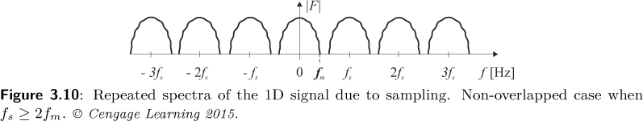
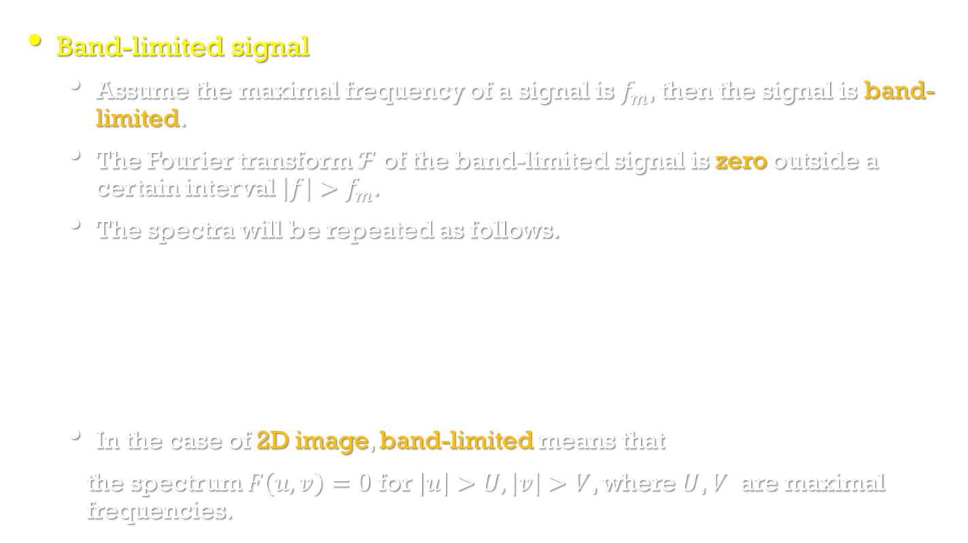
Sampling and the Shannon constraint
Image Processing, Analysis, and Machine Vision, 4th Edition Sonka, Hlavac & Boyle
Band-limited signal
Assume the maximal frequency of a signal is $f_{m}$, then the signal is band-limited.
The Fourier transform $ℱ$ of the band-limited signal is zero outside a certain interval $\left|f\right|>f_{m}$.
The spectra will be repeated as follows.
In the case of 2D image, band-limited means that
the spectrum $F\left(u,v\right)=0$ for $\left|u\right|>U,\left|v\right|>V$, where $U$, $V$ are maximal frequencies.

Slide 26
Which one is band-limited function?
$f(x)$ $F\left(ξ\right)$
(A)
FT
(D)
FT
(E)
(B)
FT
(C)
(F)

Slide 27
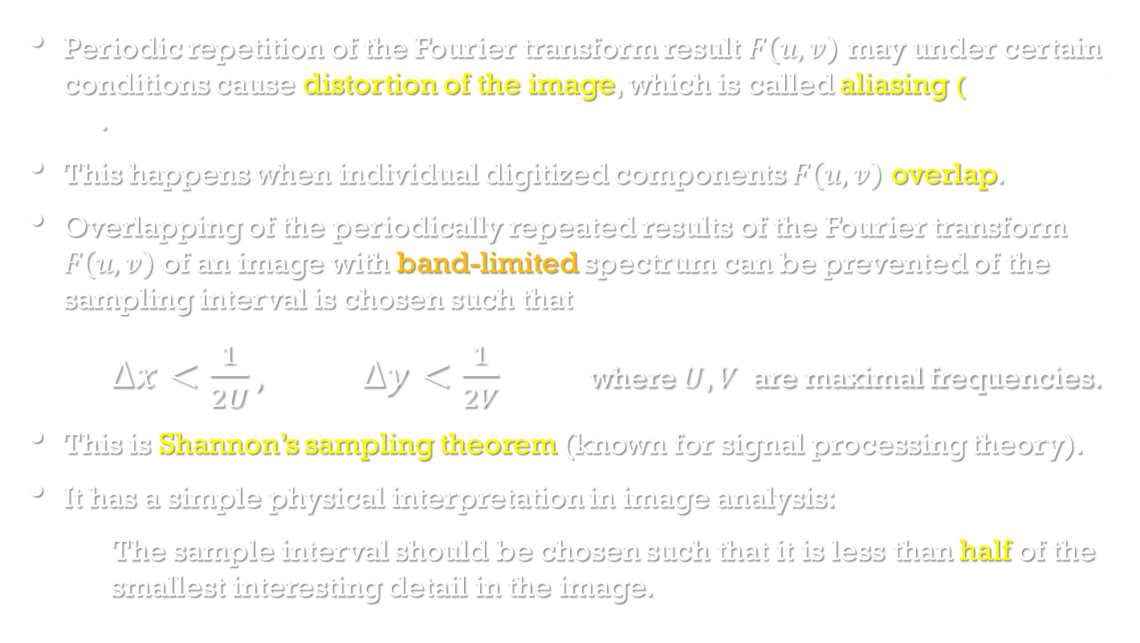
Sampling and the Shannon constraint
Image Processing, Analysis, and Machine Vision, 4th Edition Sonka, Hlavac & Boyle
Periodic repetition of the Fourier transform result $F\left(u,v\right)$ may under certain conditions cause distortion of the image, which is called aliasing (效果失真或混疊).
This happens when individual digitized components $F\left(u,v\right)$ overlap.
Overlapping of the periodically repeated results of the Fourier transform $F\left(u,v\right)$ of an image with band-limited spectrum can be prevented of the sampling interval is chosen such that
$∆x<\frac{1}{2U}, ∆y<\frac{1}{2V}$ where $U$, $V$ are maximal frequencies.
This is Shannon’s sampling theorem (known for signal processing theory).
It has a simple physical interpretation in image analysis:
The sample interval should be chosen such that it is less than half of the smallest interesting detail in the image.

Slide 28
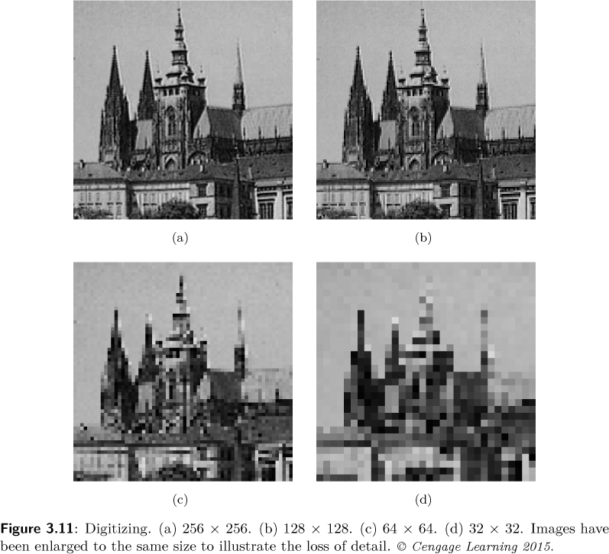
Sampling and the Shannon constraint
Image Processing, Analysis, and Machine Vision, 4th Edition Sonka, Hlavac & Boyle

Slide 29
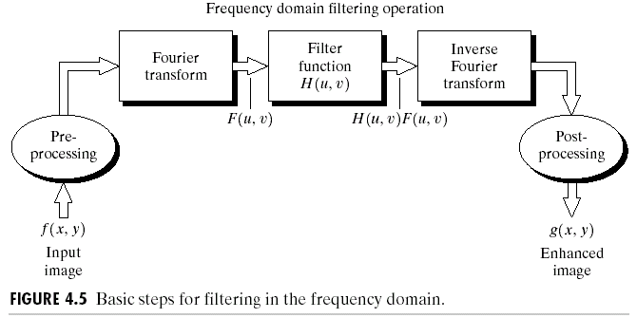
Basics of Filtering in the Frequency Domain

Slide 30
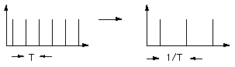
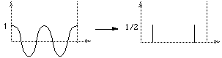
The One-Dimensional Fourier Transform
Some Examples
The transform of an infinite train of delta functions spaced by T is an infinite train of delta functions spaced by 1/T.
The transform of a cosine function is a positive delta at the appropriate positive and negative frequency.

Slide 31
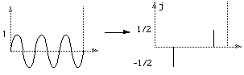
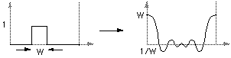
The One-Dimensional Fourier Transform
Some Examples
The transform of a sin function is a negative complex delta function at the appropriate positive frequency and a negative complex delta at the appropriate negative frequency.
The transform of a square pulse is a sinc function.

Slide 32



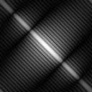
The Property of Two-Dimensional DFT
Rotation
DFT
DFT

Slide 33

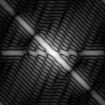
The Property of Two-Dimensional DFT
Linear Combination
A
DFT
B
DFT
0.25 * A
+ 0.75 * B
DFT

Slide 34


The Property of Two-Dimensional DFT
Expansion
A
DFT
B
DFT
Expanding the original image by a factor of n (n=2), filling the empty new values with zeros, results in the same DFT.

Slide 35

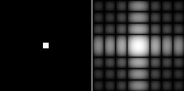
Two-Dimensional DFT with Different Functions
Sine wave
Its DFT
Rectangle
Its DFT

Slide 36


Two-Dimensional DFT with Different Functions
2D Gaussian
function
Its DFT
Impulses
Its DFT

